Slide 1
Bayesian Parameter Estimation

Slide 2
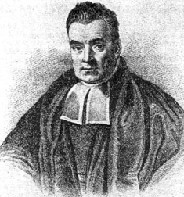
Bayesian inference
Bayesian statistics is a set of formal methods for statistical inference, used by statisticians and scientists to make statements about unobserved parameters starting from the observed data
Not to be confused with “Bayes-in-the-head”, a set of psychological theories about how lay humans perform inference in daily life

Slide 3
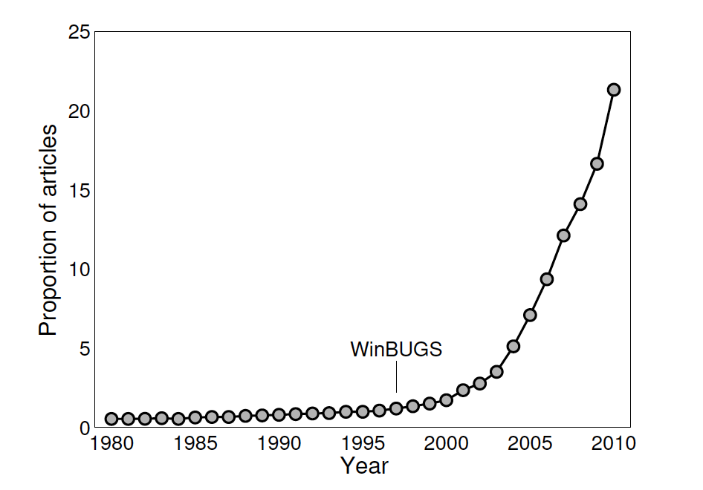
Bayesian inference
Bayesian data Analysis
Model does not have to be Bayesian
Parameter estimation procedure
Notes:
Our purpose: to fit statistical models to data
– for whatever reason!
• The model will have a number of parameters
• We want to estimate the parameters
– and then to check that the model fits
Figure: A Google Scholar perspective on the increasing popularity of Bayesian inference,
showing the proportion of articles matching the search “bayes OR bayesian -author:
bayes” for the years 1980 to 2010.

Slide 4
Some important basics
Notation
$p(a)$ is the probability density of some variable $a$
$p(a|b)$ is the probability density of $a$ assuming some value of $b$
If $a$ and $b$ independent, $p\left(a\right)=p\left(a | b\right)$.

Slide 5
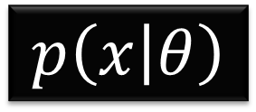
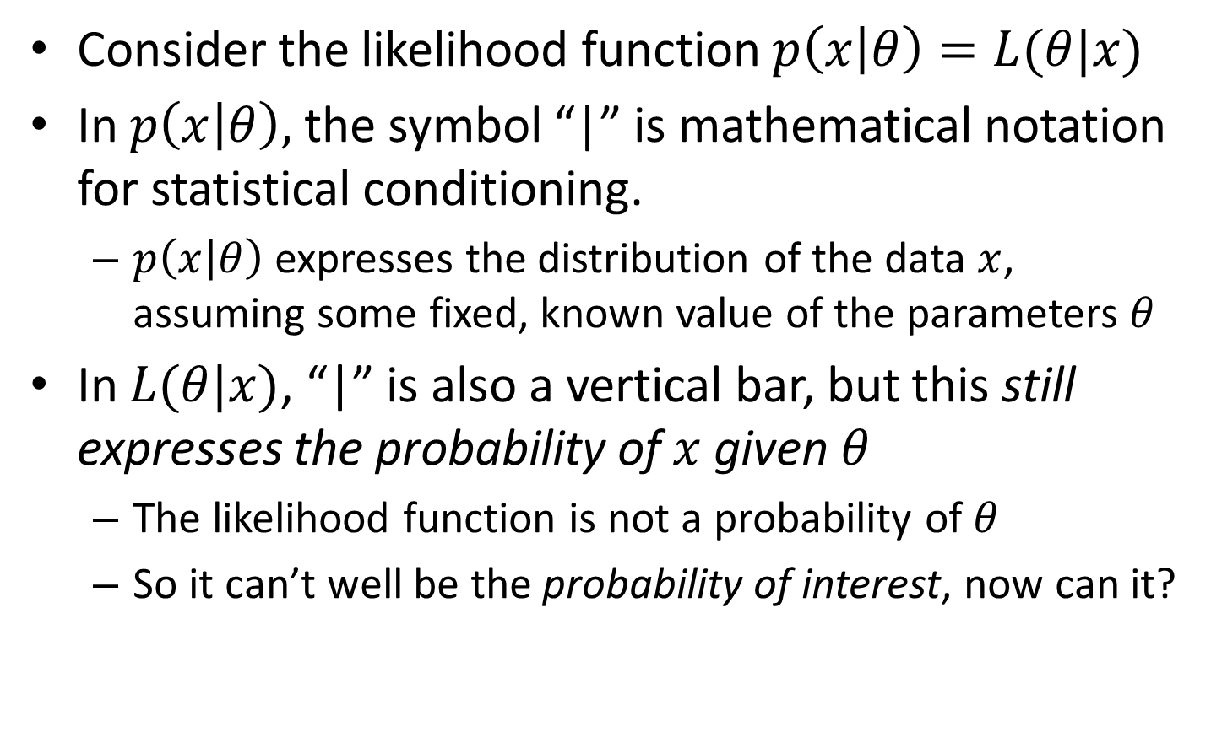
Lie-kelihood
$$p\left(x | θ\right)$$
Consider the likelihood function $p\left(x | θ\right)=L(θ|x)$
In $p\left(x | θ\right)$, the symbol “|” is mathematical notation for statistical conditioning.
$p\left(x | θ\right)$ expresses the distribution of the data $x$, assuming some fixed, known value of the parameters $θ$
In $L(θ|x)$, “|” is also a vertical bar, but this still expresses the probability of $x$ given $θ$
The likelihood function is not a probability of $θ$
So it can’t well be the probability of interest, now can it?

Slide 6


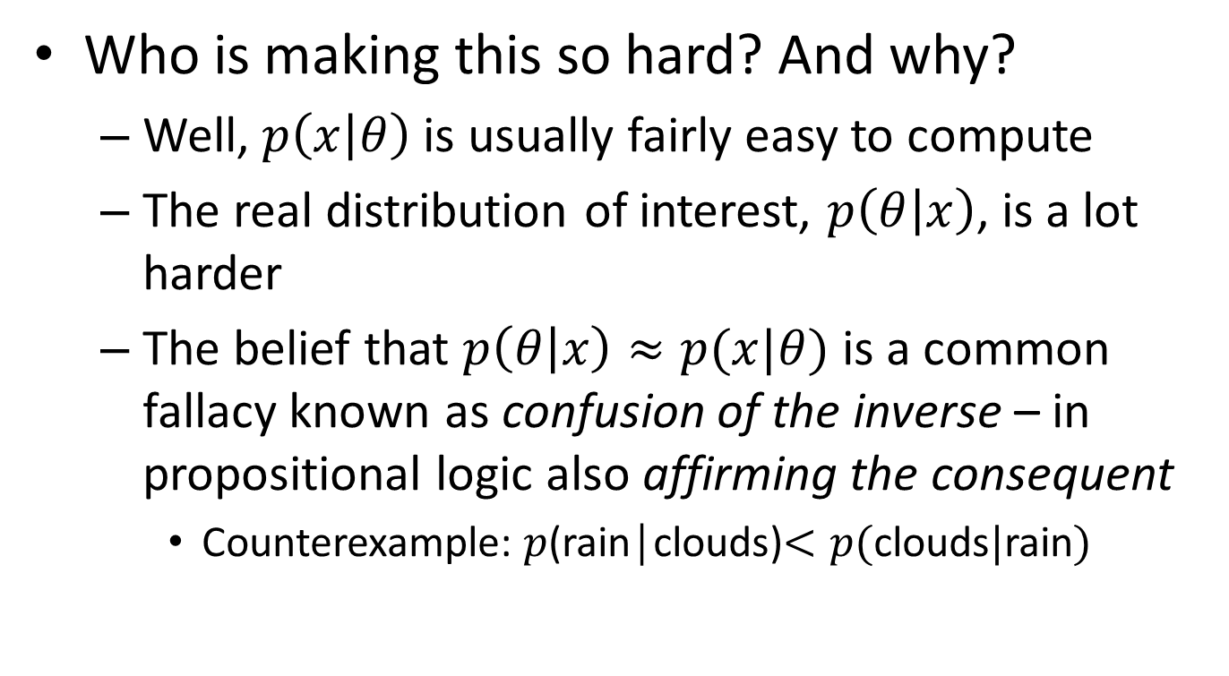
Fast and spurious
$$p\left(x | θ\right)$$
Who is making this so hard? And why?
Well, $p\left(x | θ\right)$ is usually fairly easy to compute
The real distribution of interest, $p\left(θ | x\right)$, is a lot harder
The belief that $p\left(θ | x\right)≈p(x|θ)$ is a common fallacy known as confusion of the inverse – in propositional logic also affirming the consequent
Counterexample: $p$(rain│clouds)$<p($clouds$|$rain$)$
p( | ) < p( | )

Slide 7
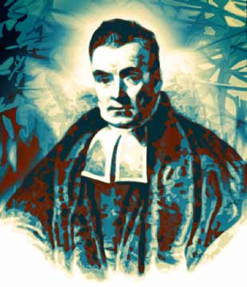
Bayes’ Rule
$$P\left(A∪B\right)=P\left(A∪B\right)$$
$$⇔P\left(B\right)P\left(A | B\right)=P\left(A\right)P\left(B | A\right)$$
$$⇔P\left(A | B\right)=\frac{P\left(A\right)}{P\left(B\right)}P\left(B | A\right)$$
$$P\left(θ | x\right)=\frac{P\left(θ\right)}{P\left(x\right)}P\left(x | θ\right)$$
$$⇔$$

Slide 8
Bayes’ Rule
$$p\left(θ | x\right)=\frac{p\left(θ\right)}{p\left(x\right)}p\left(x | θ\right)$$
Simple formulation, only four components

Slide 9
Bayes’ Rule
$$p\left(θ | x\right)=\frac{p\left(θ\right)}{p\left(x\right)}p\left(x | θ\right)$$
The likelihood, or distribution of the data $x$ assuming the model parameters $θ$

Slide 10
Bayes’ Rule
$$p\left(θ | x\right)=\frac{p\left(θ\right)}{p\left(x\right)}p\left(x | θ\right)$$
The posterior distribution or Bayesian probability, the true quantity of interest
The distribution of the model parameters $θ$, assuming the data $x$

Slide 11
Bayes’ Rule
$$p\left(θ | x\right)=\frac{p\left(θ\right)}{p\left(x\right)}p\left(x | θ\right)$$
The prior distribution expresses our beliefs or knowledge about the probability of different values for $θ$ before observing the data $x$ (but using all of our other knowledge of the world)

Slide 12
Bayes’ Rule
$$p\left(θ | x\right)=\frac{p\left(θ\right)}{p\left(x\right)}p\left(x | θ\right)$$
The normalizing constant makes sure that $p\left(θ | x\right)$ integrates to 1. It is the weighted probability of observing the data $x$ under any parameter set $θ$ that is allowed by $p\left(θ\right)$

Slide 13
Summary of the Bayesian Approach
In Bayesian parameter estimation, uncertainty with respect to parameters is quantified by probability distributions
In order to get the Bayesian inference machine off the ground, we need to specify our uncertainty with respect to the parameters before seeing the data
This uncertainty is captured by the prior distribution
After having seen the data, our updated knowledge is described by a posterior distribution
The goal is to find good estimates of the posterior distribution

Slide 14
Posterior Sampling

Slide 15
A simple example
Assume you are given a test that consist of 6 factual (true / false) questions of equal difficulty.
Also assume that you are fairly knowledgeable in this particular domain
We want to estimate your ability, which we define as the rate θ with which you answer questions correctly
What is your guess of θ before the test?
Suppose you answer 5 out of 6 questions correctly. Now what is your guess?

Slide 16
Setting up the Problem
Prior: Beta(2,2) on the interval 0.5 to 1
Likelihood: Binomial with 6 trials and 5 successes

Slide 17
Setting up the Problem
Given those, building the posterior is trivial:

Slide 18
Exercise
Implement this and plot the three functions

Slide 19
Solution

Slide 20
Posterior Inference
The posterior distribution gives a lot of information
Ideally, we could just show a graph of it and leave the interpretation of the reader
But often the posterior will have many dimensions
We need a way to describe the posterior distribution
Mean, SD, Skew, etc.

Slide 21
Posteriors are Difficult
Only very simple models have analytical posterior distributions
For a long time, this restricted Bayesian inference to a very small upset of models

Slide 22
Different Classes of Problems
Very few cognitive models
Most cognitive models
Complex models, e.g., LCA, MDFT, pLBA

Slide 23
Posterior Sampling
How can we compute the posterior when there isn’t an analytical solution?
As it turns out, drawing random samples from a distribution is an efficient way to do that
Methods for doing this are called Monte Carlo methods

Slide 24
The Rejection Sampler
One Monte Carlo method is the rejection sampler
Generates sampling values from a target distribution X with arbitrary probability density function f(x) by using a proposal distribution Y with probability density g(x).
Can generate a sample value from X by instead sampling from Y (the proposal P_{R}) and accepting P_{R} with probability f(P_{R}) /(M*g(P_{R}))

Slide 25
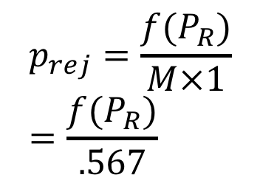
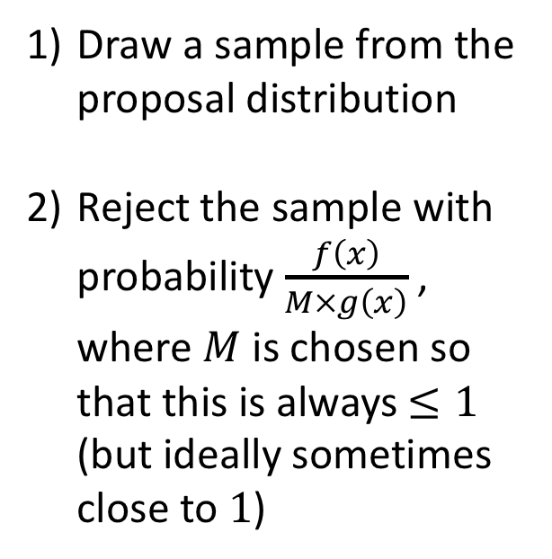
Applying it to the Rate Problem
Draw a sample from the proposal distribution
Reject the sample with probability $\frac{f\left(x\right)}{M×g\left(x\right)}$ , where $M$ is chosen so that this is always $≤1$ (but ideally sometimes close to $1$)
$$p_{rej}=\frac{f(P_{R})}{M×1}=\frac{f(P_{R})}{.567}$$

Slide 26
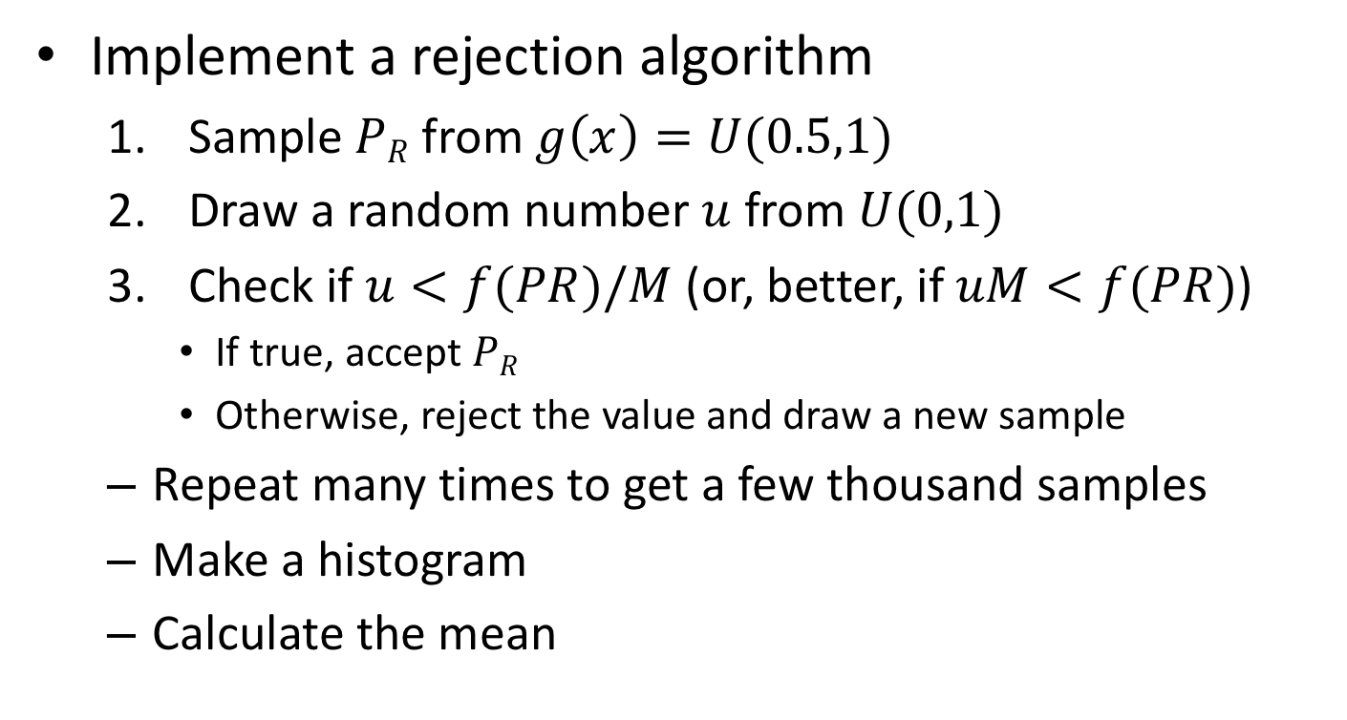
Exercise
Implement a rejection algorithm
Sample $PR$ from $g\left(x\right)=U(0.5,1)$
Draw a random number $u$ from $U(0,1)$
Check if $u<f(PR)/M$ (or, better, if $uM<f(PR)$)
If true, accept $PR$
Otherwise, reject the value and draw a new sample
Repeat many times to get a few thousand samples
Make a histogram
Calculate the mean

Slide 27
Solution

Slide 28
Solution

Slide 29
Exercise
Now change the number of questions and number correct to 10 and 9
What happens?

Slide 30
Steve’s Animation
Now we’ll see something cool from Steve

Slide 31
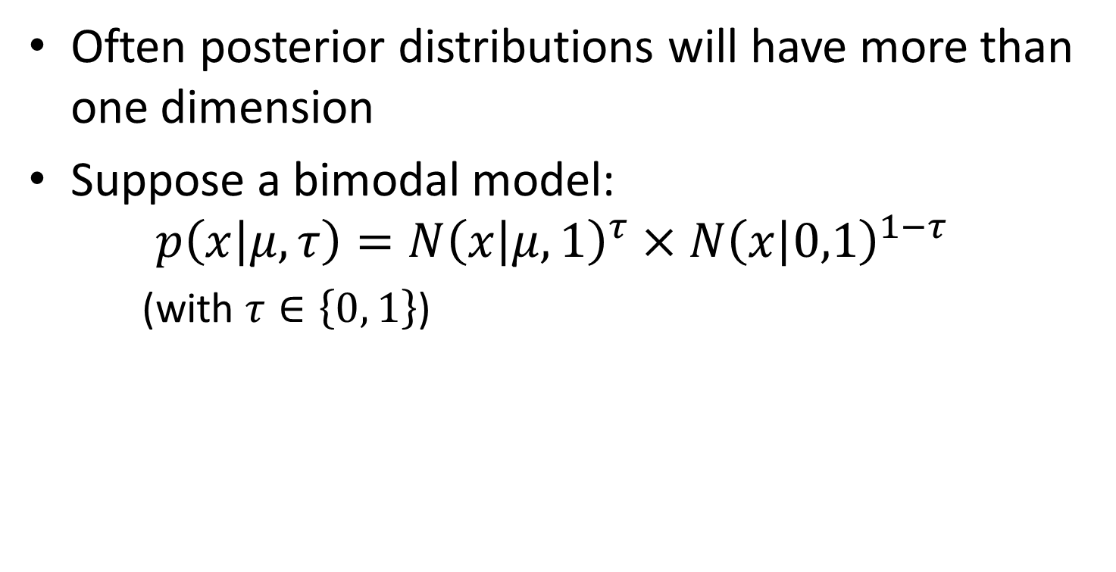
Multidimensional sampling
Often posterior distributions will have more than one dimension
Suppose a bimodal model:
$$p\left(x | μ,τ\right)=N{\left(x | μ,1\right)}^{τ}×N{\left(x | 0,1\right)}^{1−τ}$$
(with $τ∈\left\{0, 1\right\}$)

Slide 32
Markov chain Monte Carlo
Markov chain Monte Carlo (MCMC) is used for approximating a multi-dimensional integral
MCMC techniques include
Gibbs sampling (JAGS: Just Another Gibbs Sampler)
Metropolis-Hastings algorithm

Slide 33
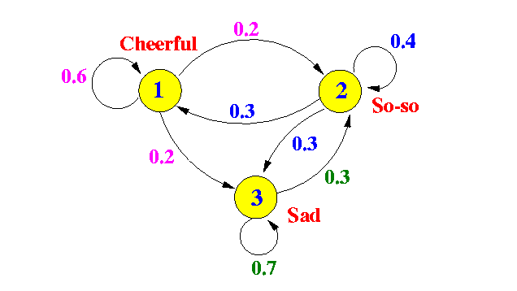
“Markov Chain” part of MCMC
Markov Chain is essentially a fancy term for a random walk on a graph
Stationary distribution theorem: for a very long random walk, the probability that you end at a vertex v is independent of where you started

Slide 34
Constructing a graph to walk on
Goal is to come up with a graph that has the right stationary distribution
AND where you can prove that the convergence of a random walk to the stationary distribution is fast in comparison to the size of X

Slide 35
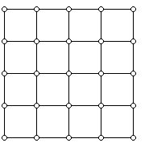
One solution
Step 1: pick a graph
e.g., lattice
Step 2: Describe the transition probabilities
Let r be the max degree of vertex i
Pick neighbor j with probability 1/r
If you picked neighbor j and p(j) ≥ p(i), then go to j
Otherwise, p(j) < p(i) and you go to j with probability p(j)/p(i)
Notes:
Note that there is some chance to stay at i

Slide 36
Comments
Proven that p(x) is the stationary distribution for this walk
Now, you can just randomly walk according to these probabilities and get a sample
This is the Metropolis-Hastings algorithm
Gibbs sampling, in its basic incarnation, is a special case of the Metropolis-Hastings algorithm

Slide 37
Introduction to JAGS

Slide 38
Revisiting the Rate Problem
Assume you are given a test that consist of 10 factual questions of equal difficulty. We want to estimate your ability, which we define as the rate θ with which you answer questions correctly
Suppose you answer 9 out of 10 questions correctly.

Slide 39
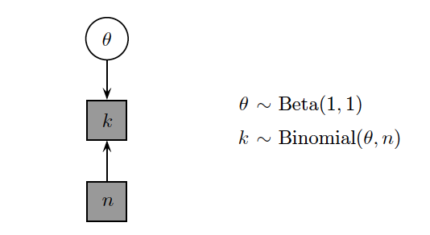
Graphical Model for the Rate Problem
Continuous, unobserved variable
Discrete, observed variables
Notes:
We use the conventions of representing unobserved variables without shading and observed variables with shading, and continuous variables with circular nodes and discrete variables with square nodes

Slide 40
Graphical models
A graphical model specifies a complete joint probability distribution (JPD) over all the variables.
Probabilistic graphical models are graphs in which nodes represent random variables
Arrows represent conditional independence assumptions
directed models
one can regard an arrow from A to B as indicating that A ``causes'' B
can encode deterministic relationships
must specify the Conditional Probability Distribution (CPD) at each node

Slide 41
Graphical Model Notation

Slide 42
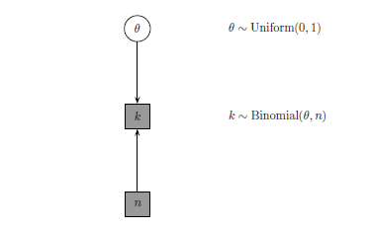
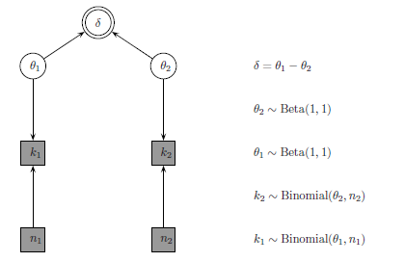
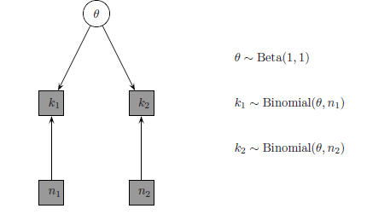
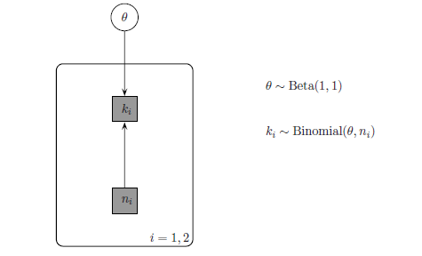
Examples of Graphical Models
Notes:
Inferring the rate of a binary process
Inferring a common rate
Inferring the difference between two rates
Circles denote continuous-valued random variables, squares denote discrete rv's, clear means hidden, and shaded means observed, double-bordered means deterministic (one that is defined that is defined in terms of other variables)

Slide 43
Implementation
Need three things:
JAGS (http://sourceforge.net/projects/mcmc-jags/files/)
rjags (http://cran.r-project.org/web/packages/rjags/index.html)
R2jags (install.packages("R2jags"))

Slide 44
Implementation

Slide 45
Let’s look at some code
Open Rate_1_jags.R and Rate_1.txt

Slide 46
Model Specification
# Inferring a Rate
model{
# Prior Distribution for Rate Theta
theta ~ dbeta(1,1)
# Observed Counts (k out of n questions correct)
k ~ dbin(theta,n)
}

Slide 47
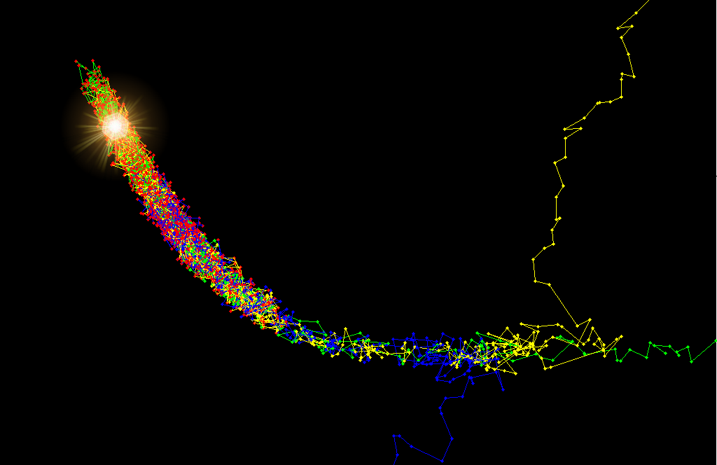
JAGS
JAGS takes care of all of the sampling, but we have to set some parameters for this
Number of chains
Number of samples
Burn-in
Samples from regions where the posterior probability is high and the chains begin to mix

Slide 48
JAGS User Manual
Great resource for the distributions and functions available in JAGS

Slide 49
Exercise
Alter the data to k = 50 and n = 100, and compare the posterior for the rate theta to the original with k = 5 and n = 10
For both the k = 50, n = 100 and k = 5, n = 10 cases just considered, re-run the analyses with many more samples by changing the n.iter variable. What controls the width of the posterior? What controls the quality of the approximation of the posterior?

Slide 50
R-hat Statistic
When the sampling process has converged, chains with substantially different starting values should be indistinguishable from each other
Formal test of converge is the R-hat statistic – measures between-chain to within-chain variance
Values close to 1 indicate convergence, values higher than 1.1 are (deeply) suspect
Notes:
Values greater than 1.1 indicate that the between-chain variance is greater than the within-chain variance, thus the chains didn’t converge.

Slide 51
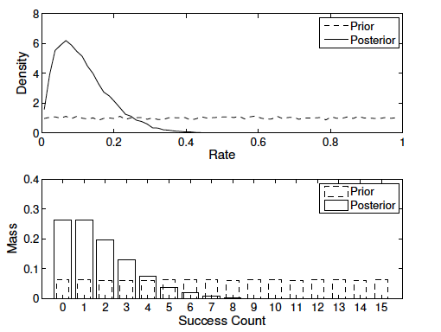
Predictive Distributions
Predictive distributions are distributions over data
Notes:
Prior and posterior for the success rate theta (top panel), and prior and posterior
predictive for counts of the number of successes (bottom panel), based on data giving
k = 1 successes out of n = 15 trials.

Slide 52
Why are Predictive Distributions Important?
They allow us to examine the descriptive adequacy of a model
The posterior predictive distribution is a prediction about what data the model expects to see
If the actual data is different, then we have a problem -> The model is bad

Slide 53
Signal Detection Theory

Slide 54
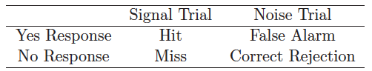
Signal Detection Theory
Applicable to 2AFC experiments or any situation that can be conceived as a 2 x 2 table of counts
There are ‘signal’ trials and ‘noise’ trials, and ‘yes’ responses and ‘no’ responses
The data for SDT analysis are just counts of hits, false alarms, misses and correct rejections

Slide 55
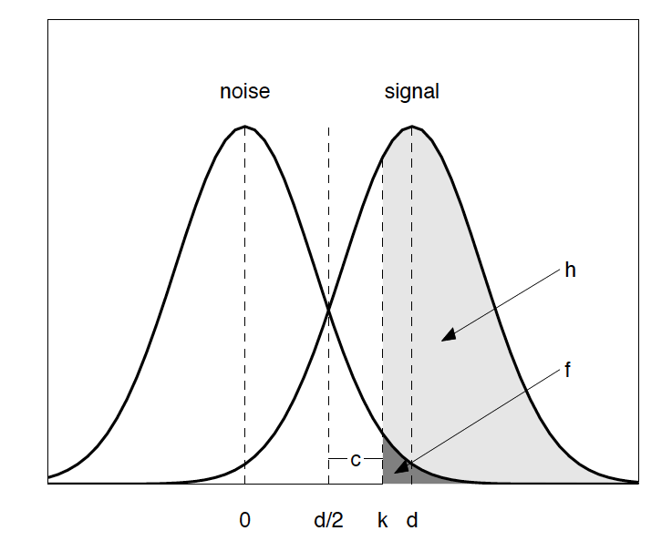
Equal-variance Gaussian Signal Detection Theory Framework
mean of noise = 0
d = discriminability (the distance between the means of the signal and noise distributions)
d/2 = criterion value at which both signal and noise distributions are equally likely
k = actual criterion used for responding
c = distance between k and d/2
Hit rate
FA rate

Slide 56
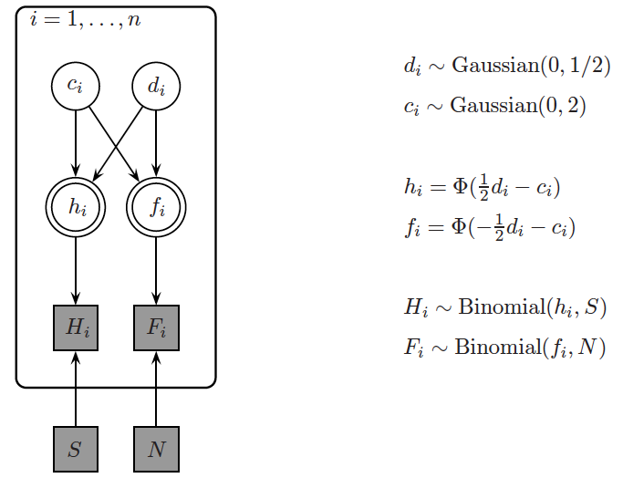
Graphical Model
Number of datasets (e.g., different groups of people)
SDT bias parameter
SDT discriminability parameter
False alarm rate
Hit rate
Number of hits
Number of false alarms
Number of signal trials
Number of noise trials
Notes:
f_i: the area from d/2+c to inf. Because of symmetry around 0, this is the same as the area from –inf to -(d/2+c), which is given by the CDF
h_i: first shift the distribution to have mean 0 by subtracting d. Then, h_i is the area from (d/2+c) –d to inf (i.e., -d/2+c). Because of symmetry around 0, this is the same as the area from –inf to –(-d/2+c), which is –inf to d/2-c

Slide 57
Code
# Signal Detection Theory
model{
for (i in 1:k){
# Observed counts
h[i] ~ dbin(thetah[i],s[i])
f[i] ~ dbin(thetaf[i],n[i])
# Reparameterization Using Equal-Variance Gaussian SDT
thetah[i] <- phi(d[i]/2-c[i])
thetaf[i] <- phi(-d[i]/2-c[i])
# These Priors over Discriminability and Bias Correspond
# to Uniform Priors over the Hit and False Alarm Rates
d[i] ~ dnorm(0,0.5)
c[i] ~ dnorm(0,2)
}
}
Use hit and FA rates to model hit and FA counts
Hit and FA rates from SDT
Priors on SDT parameters

Slide 58
Comparing Datasets
Three data sets:
70 hits and 50 false-alarms observed in 100 target and 100 distractor trials
7 hits and 5 false-alarms observed in 10 target and 10 distractor trials
10 hits and 0 false-alarms observed in 10 target and 10 distractor trials

Slide 59
Exercise
Consider the results from the following recognition memory experiment with odors:
Modify the SDT code to fit this data
What conclusions can you draw?

Slide 60
Solution

Slide 61
Memory Retention

Slide 62
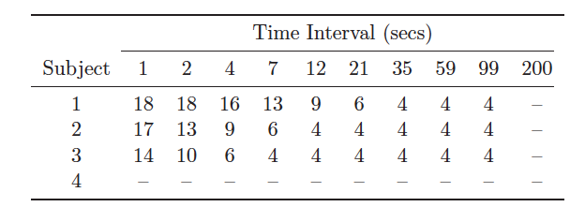
Memory Retention
Typical task:
study a list of items
Recall as many items as you can (tested at different times)
Data from Rubin et al. (1999)
Tested on 18 items at 10 time intervals
Missing data

Slide 63
Exponential Decay Model
The probability that an item will be remembered after a period of time t has elapsed is
Rate of decay of information
Baseline level of remembering

Slide 64
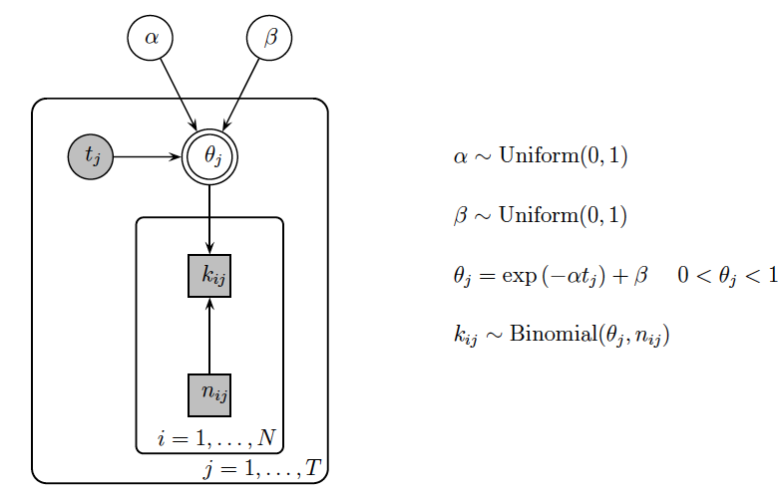
Graphical Model (No Individual Differences)
Same decay rate and baseline for all people
Different rate for each time interval, but same for all people
Time interval
Number of items recalled
Number of items (i.e., 18)

Slide 65
Code
model{
# Observed and Predicted Data
for (i in 1:ns){
for (j in 1:nt){
k[i,j] ~ dbin(theta[i,j],n)
predk[i,j] ~ dbin(theta[i,j],n)
}
}
# Retention Rate At Each Lag For Each Subject Decays Exponentially
for (i in 1:ns){
for (j in 1:nt){
theta[i,j] <- min(1,exp(-alpha*t[j])+beta)
}
}
# Priors
alpha ~ dbeta(1,1)
beta ~ dbeta(1,1)
}
Fits to observations
Posterior predictive

Slide 66
Exercise
Draw the graphical model assuming full individual differences

Slide 67
Solution: Full Individual Differences

Slide 68
Exercise
Implement the full individual differences model

Slide 69
Solution: Side by Side Comparison of Code

